Slide 1
YUVAINTERN / INTERNSHIP PRESENTATION
PROJECT IN ONE VIEW
CivicConnect
01
COMMUNITY
Join approved local communities
Community-Driven
E-Governance Platform
02
ISSUES
Raise and support civic issues
From reporting local issues to building visible, community-led civic participation.
03
ACTION
Volunteer in approved initiatives
04
MAP
Discover privacy-safe civic activity
NAMAN • 25SCS1003004379
Semester 3 • 2CSE18 • Session 2025-29
05 AUG 2026 → 02 SEP 2026
Junior Web Developer — E-Governance & Digital Services

Slide 2
01 / INTERNSHIP
Internship Overview
A four-week remote internship focused on practical web development for digital civic services.
Organization
Duration
Role
YuvaIntern
Remote internship
05 Aug 2026 - 02 Sep 2026
4 weeks
Junior Web Developer
E-Governance & Digital Services
Internship Focus
Design and develop user-friendly web interfaces for e-governance use cases, translate requirements into a working prototype, test core flows, and improve usability, performance and security.
02

Slide 3
02 / PROBLEM
Why CivicConnect?
Traditional complaint portals often stop at issue submission. CivicConnect extends the flow into community participation.
Fragmented Civic Action
Low Community Visibility
Need for Transparency
Complaints, local discussions, volunteering and public activity are often separated across different channels.
Residents may not know which local issues are active, what improvements are proposed, or where civic work is scheduled.
Citizens need a clear path from raising an issue to tracking review, approval, participation and outcomes.
Goal: connect reporting + community collaboration + approved civic initiatives in one responsive platform.
03

Slide 4
03 / SOLUTION
The CivicConnect Experience
A community-first civic platform built around simple, traceable actions.
Join Communities
Raise Civic Issues
Suggest Improvements
Discover and join approved local communities.
Submit local problems and track civic discussions.
Propose community-led improvements separately from complaints.
Volunteer
Activity Map
Participation Record
Participate in approved and scheduled civic initiatives.
Search locality manually and view privacy-safe public civic activity.
Track community involvement and civic contribution.
04

Slide 5
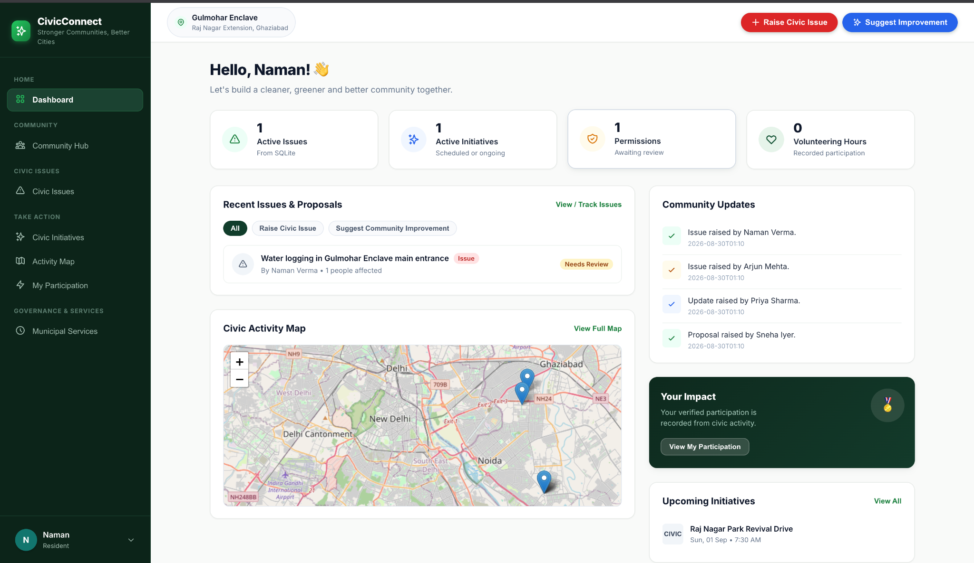
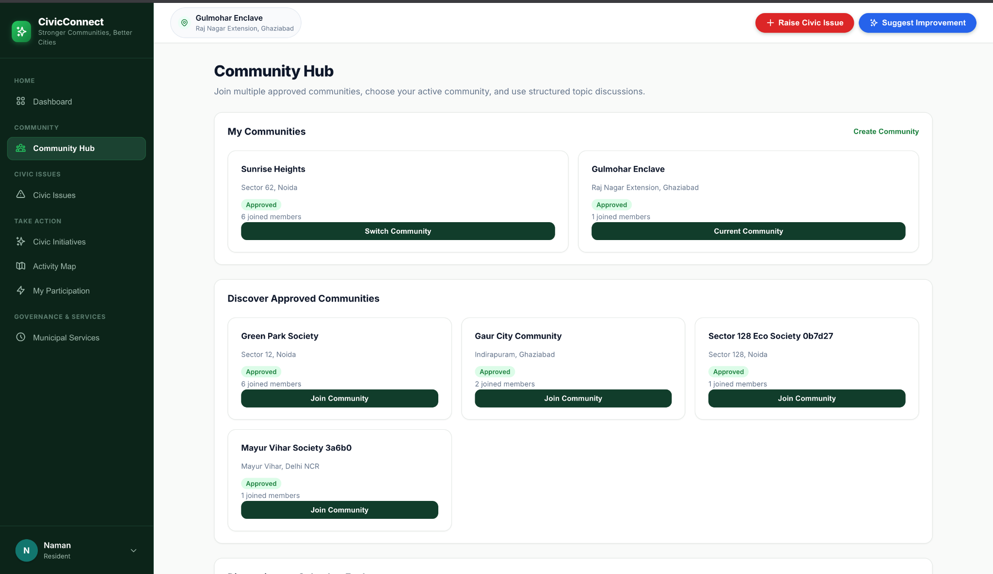
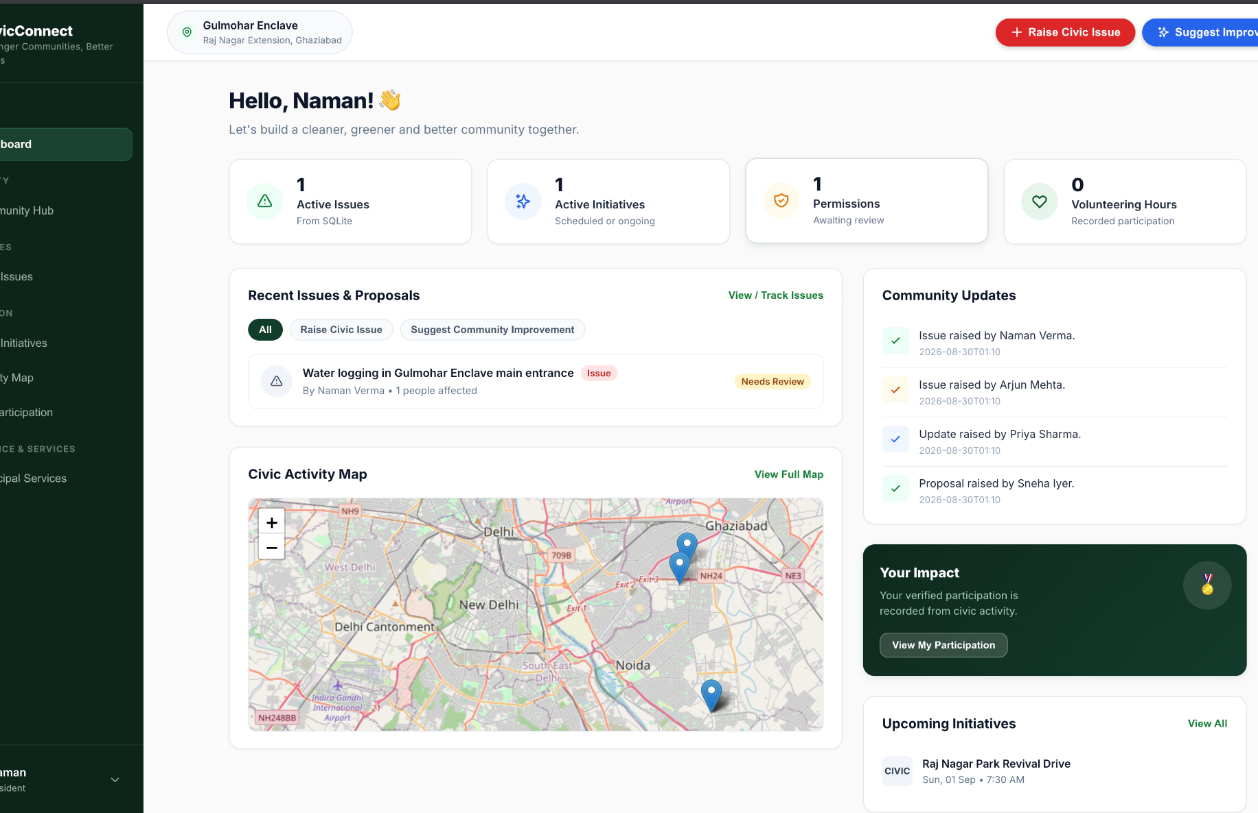
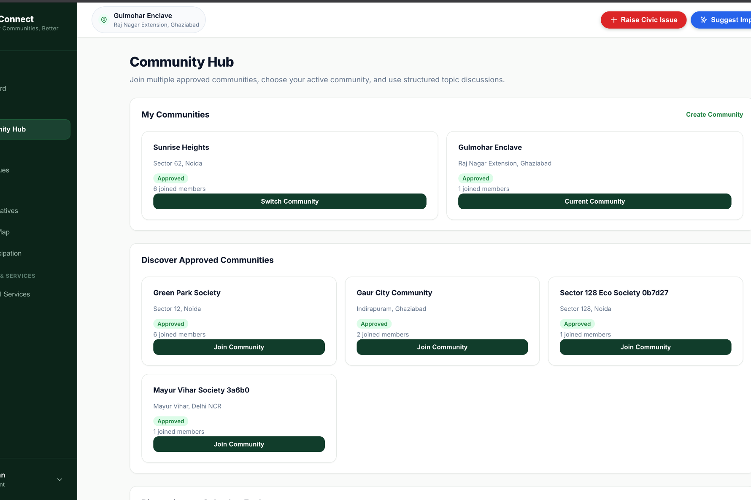
04 / PROTOTYPE
Dashboard & Community Hub
The Week 2 prototype converted the concept into a working responsive interface.
Dashboard
Community Hub

Slide 6
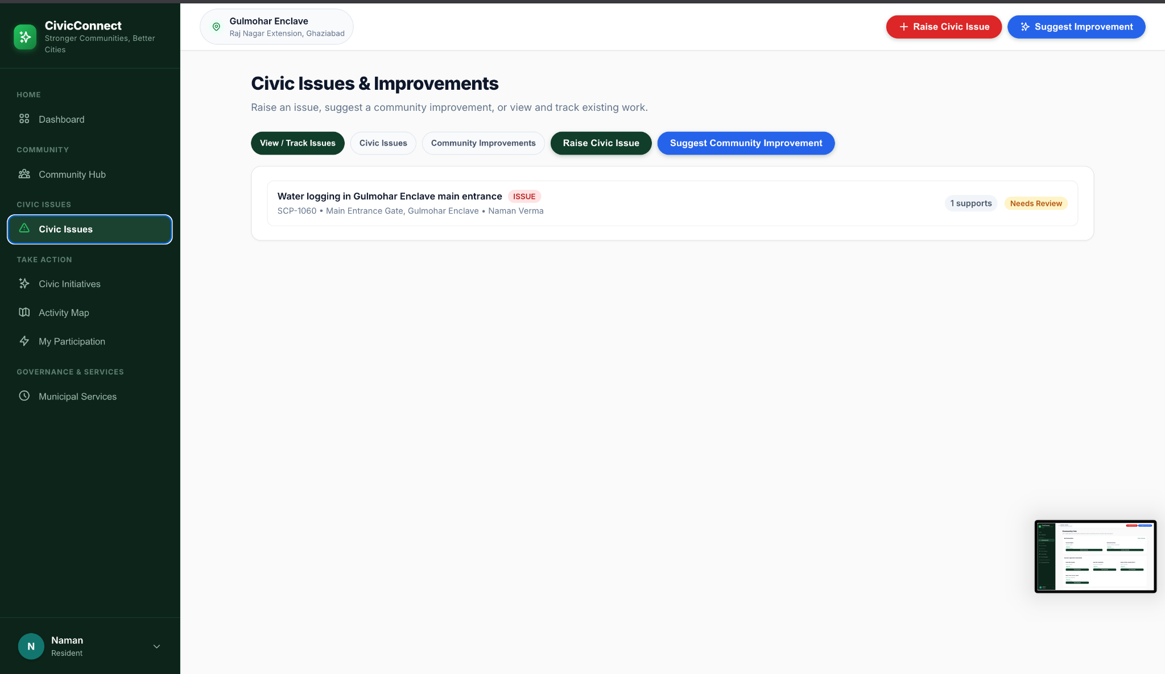
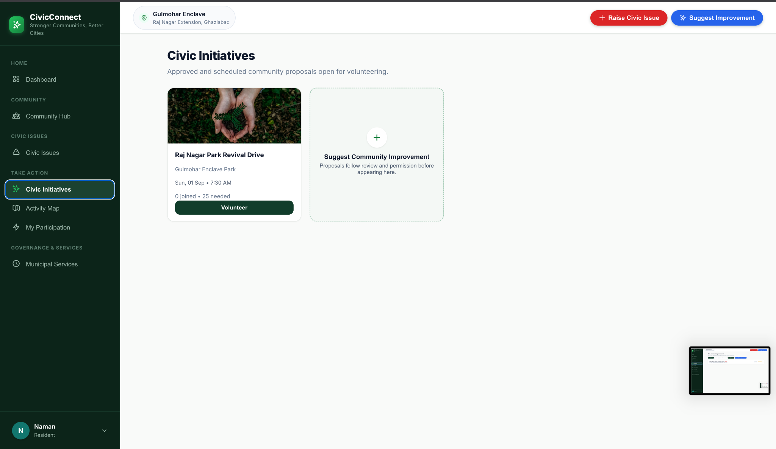
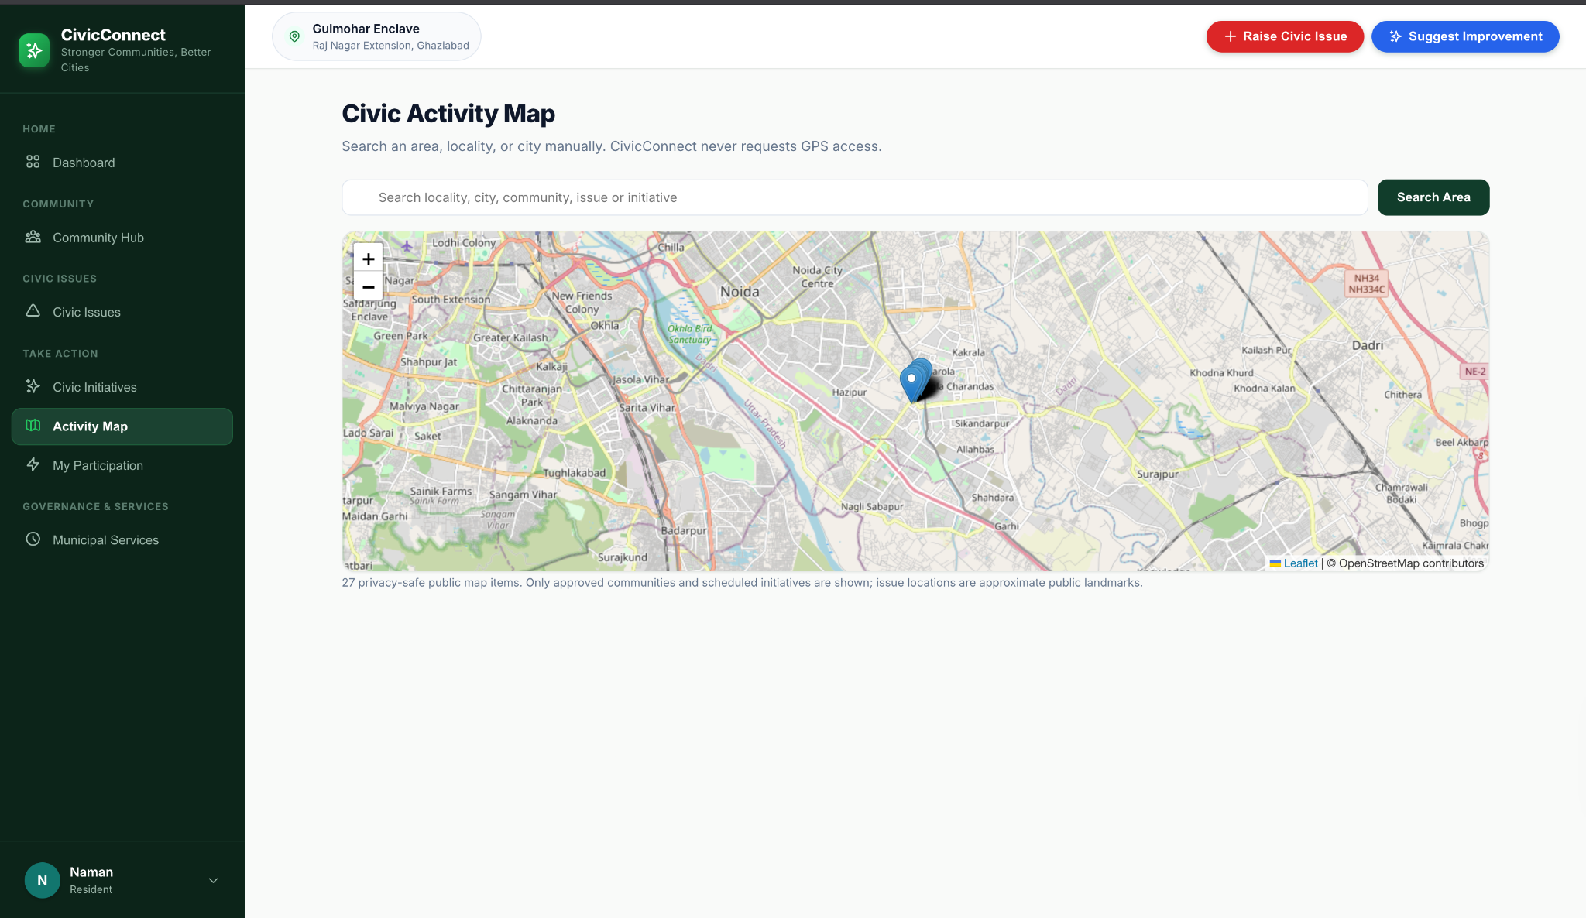
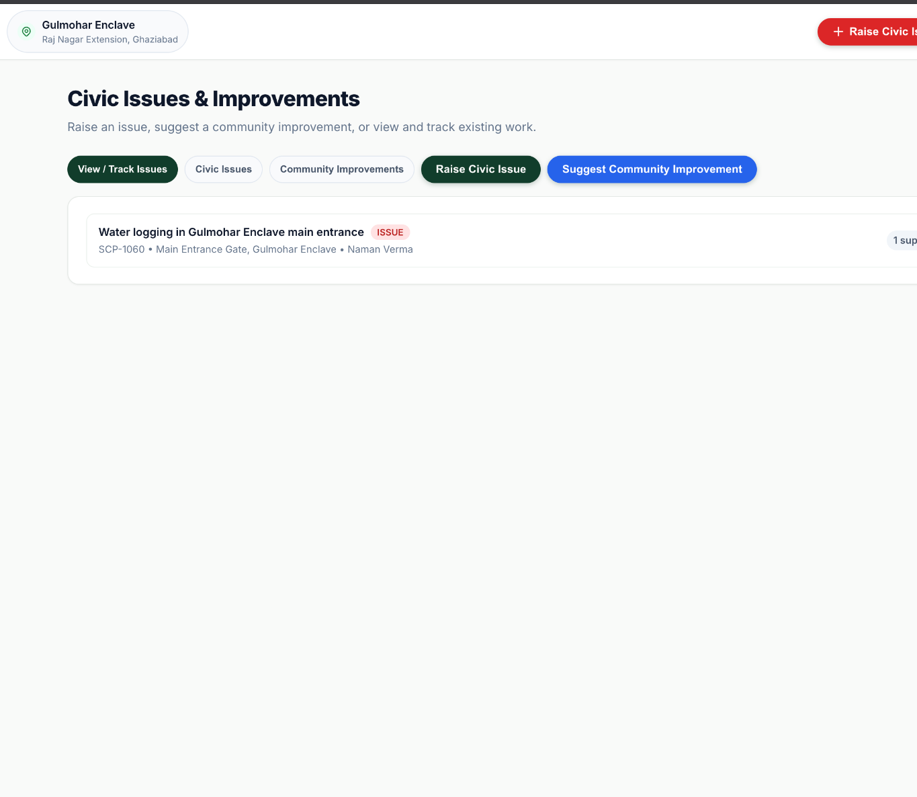
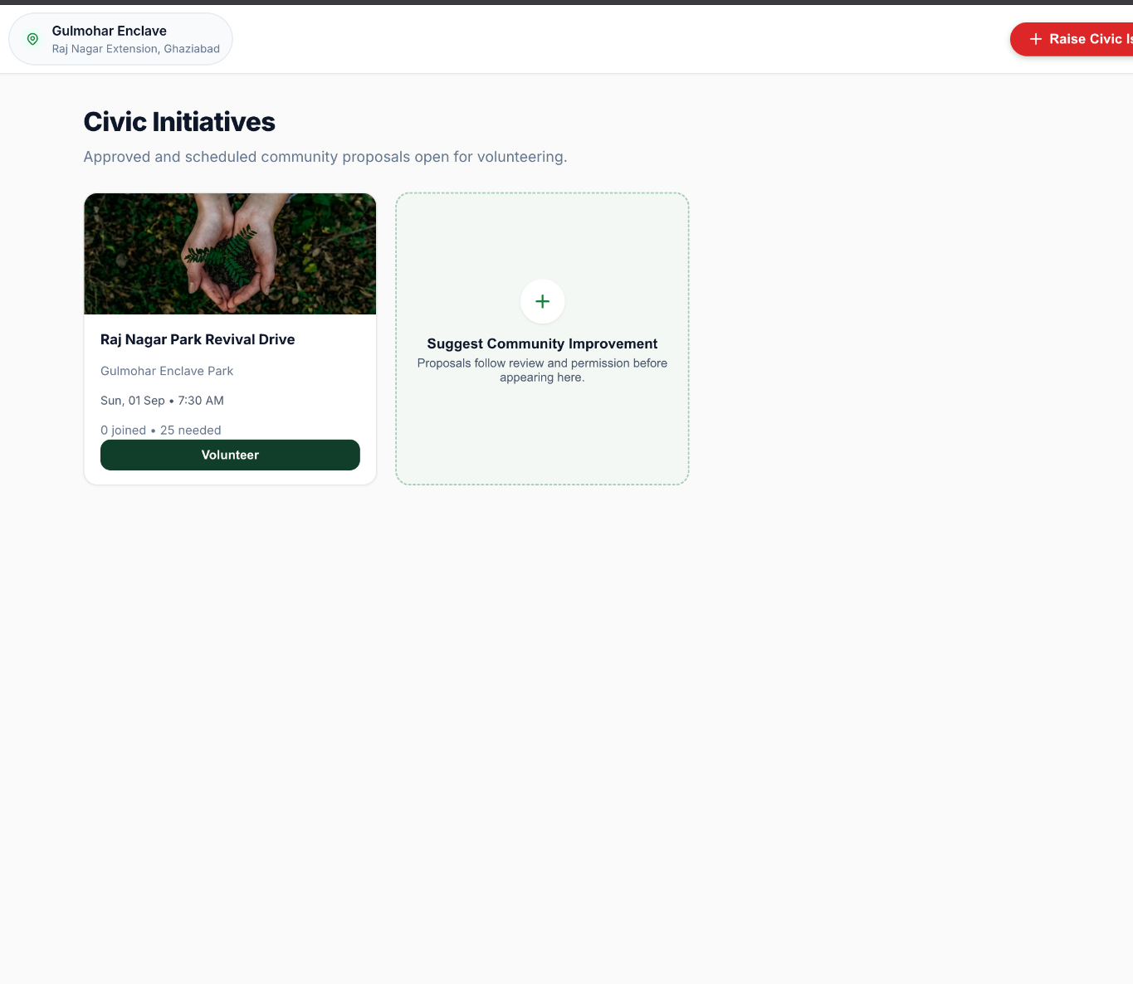
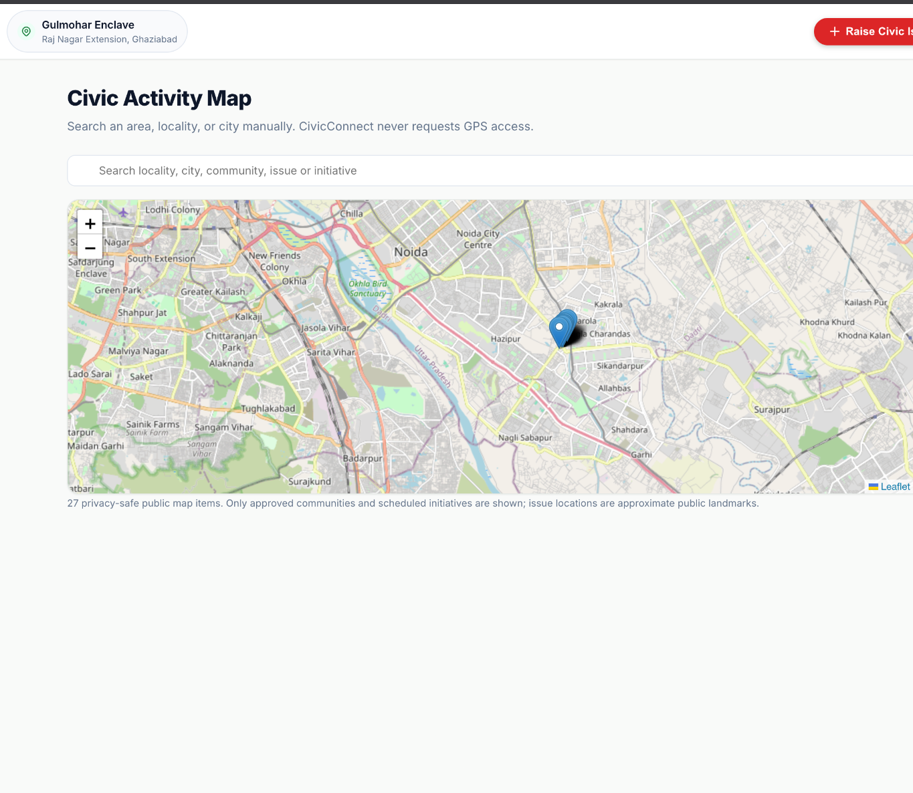
05 / CORE MODULES
Issues, Initiatives & Civic Activity Map
Key modules keep government-facing issues separate from community-led participation.
Issues & Improvements
Civic Initiatives
Activity Map

Slide 7
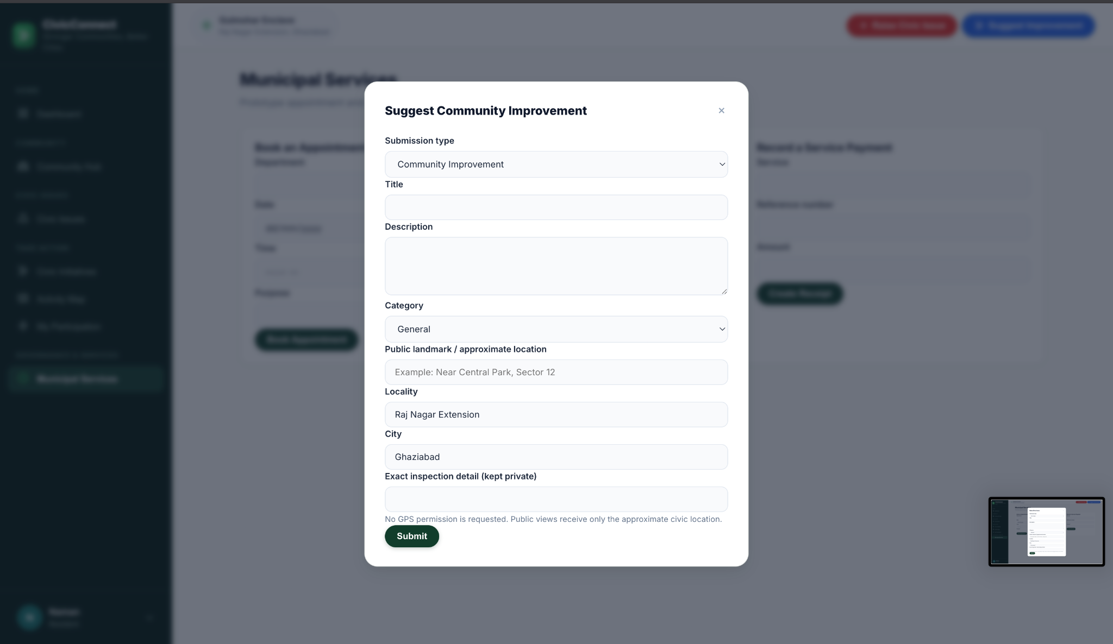
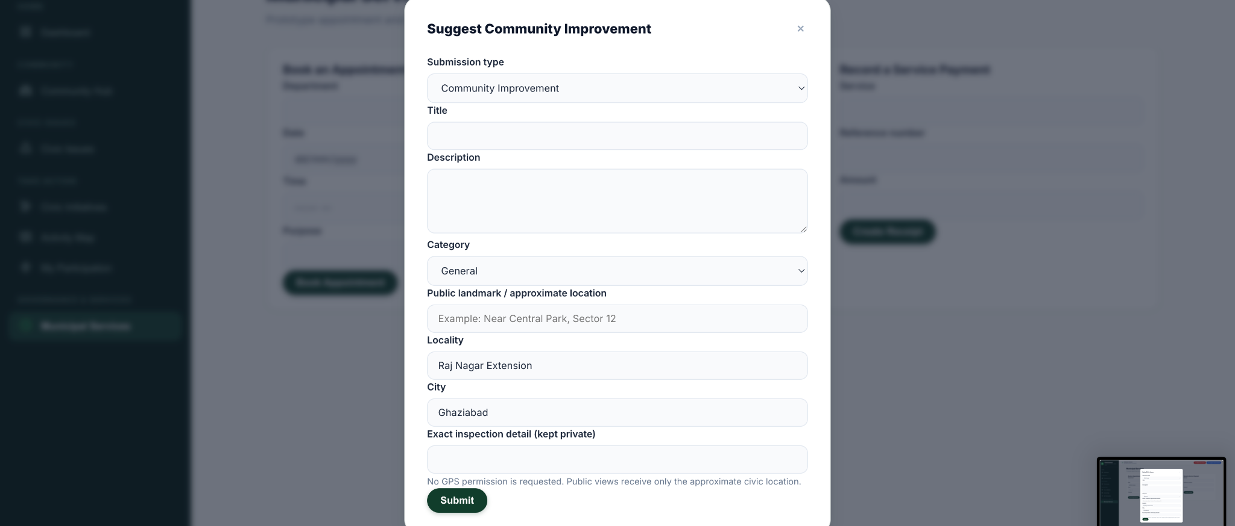
06 / WORKFLOW
From Local Issue to Civic Participation
The platform connects individual reporting with reviewed community action.
Login / Dashboard
Join Community
Issue or Improvement
Review
Approved Initiative
Volunteer
Public Activity Map
→
→
→
→
→
→
Structured forms capture locality and privacy-aware details without exposing unnecessary precise location data.
07

Slide 8
07 / TECHNOLOGY
Technology Stack
A lightweight stack suitable for a student prototype and rapid iteration.
Frontend
Backend
Database
HTML5 • CSS3 • JavaScript
React via React.createElement
Python 3.13
Flask 3.1
SQLite3
Relational persistence
Maps
Development
Testing
Leaflet
OpenStreetMap
Git • GitHub
Local Flask environment
Flask test client
Python + JS syntax checks
08

Slide 9
08 / DEVELOPMENT
Four Weeks of Work
The project moved from planning to a working prototype, then testing and final improvements.
01
02
03
04
PLAN
BUILD
TEST
IMPROVE
Planning and Requirements
Responsive Prototype
Testing and Bug Fixes
Final Review
Defined the project scope, user needs, main features and basic system flow.
Built CivicConnect with communities, civic issues, improvements, initiatives and the activity map.
Tested the main user flows, found real issues and fixed them before retesting.
Reviewed performance, accessibility and security, then made the final improvements.
Planning → Prototype → Testing → Improvement
09

Slide 10
09 / QA
Testing & Defect Resolution
Testing covered complete user flows, backend validation, persistence and authorization boundaries.
12 / 12
4 / 4
0 Critical
Representative test cases passed in the final Week 3 suite.
Documented Week 3 defects fixed and successfully retested.
No critical unresolved defects remained in the representative suite.
Examples Tested
Notable Fixes
Login • community membership • issue submission • duplicate-action prevention • discussions • initiatives • map data • role restrictions
Blank-screen JavaScript failure • map/modal overlap • missing map actions • dashboard aggregation HTTP 500
10

Slide 11
10 / AUDIT
Performance, Accessibility & Security
Week 4 focused on improving the existing build instead of adding unnecessary features.
Performance
Accessibility
Security & Privacy
Added six SQLite indexes for frequent community, post, initiative, membership and support lookups. Local API response times improved in measured endpoints.
Reviewed labels, modal behavior, keyboard access, contrast criteria and map limitations. Added Escape-key modal closing.
Reviewed authorization, SQL injection exposure, session behavior and DOM-XSS risk. Added centralized HTML escaping for map popup content.
Scope was kept realistic: no claims of production-scale load testing, destructive penetration testing or full WCAG compliance.
11

Slide 12
11 / OUTCOME
Learning & Final Outcome
CivicConnect became a working, tested e-governance prototype with a clear path for future development.
✓
Requirement analysis → implementation
✓
Responsive UI and user-flow design
✓
Flask routes and SQLite persistence
✓
Debugging and regression testing
✓
Privacy-aware map design
✓
Performance, accessibility and security review
✓
Git/GitHub project workflow
✓
Turning feedback into iterative improvements
Thank You
12

